Slide 1

REAL TIME STUDENT PROGRESS TRACKING WEB APP
RUNTIME TERROR // NEED FOR CODE

Slide 2

The problem

Slide 3

IT IS TIME CONSUMING

Slide 4

IT IS VERY LIMITED AND CONFUSING

Slide 5
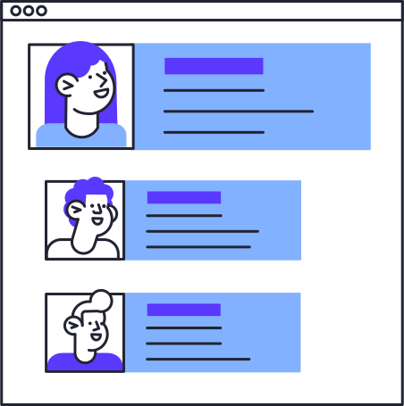
RESULTS ARE ABSOULTE
Results processed are absolute.
It is difficult to comprehend if the student is lacking behind others in a specific subject or performing top tier in their class.

Slide 6


PROGRESS REPORTS DOESN’T SHOW REAL STUDENT PROGRESS
No Graphs
No Stats
No Personal Betterment Measure
No Incentive to Perform Better

Slide 7

STUDENT MONITORING SYSTEMS IN 2022 is broken
Seeing the advancements in technology, we have accelerated healthcare, working infrastructure, public amenities however after Covid Era we only got back to traditional education institutes methodology.
Which is s l o w , time-consuming, limited confusing and boring.
TL; DR - It is BROKEN.

Slide 8

THE SOLUTION

Slide 9

AN END TO END SOLUTION FOR SCHOOLS TO PROMOTE Healthy student development.

Slide 10
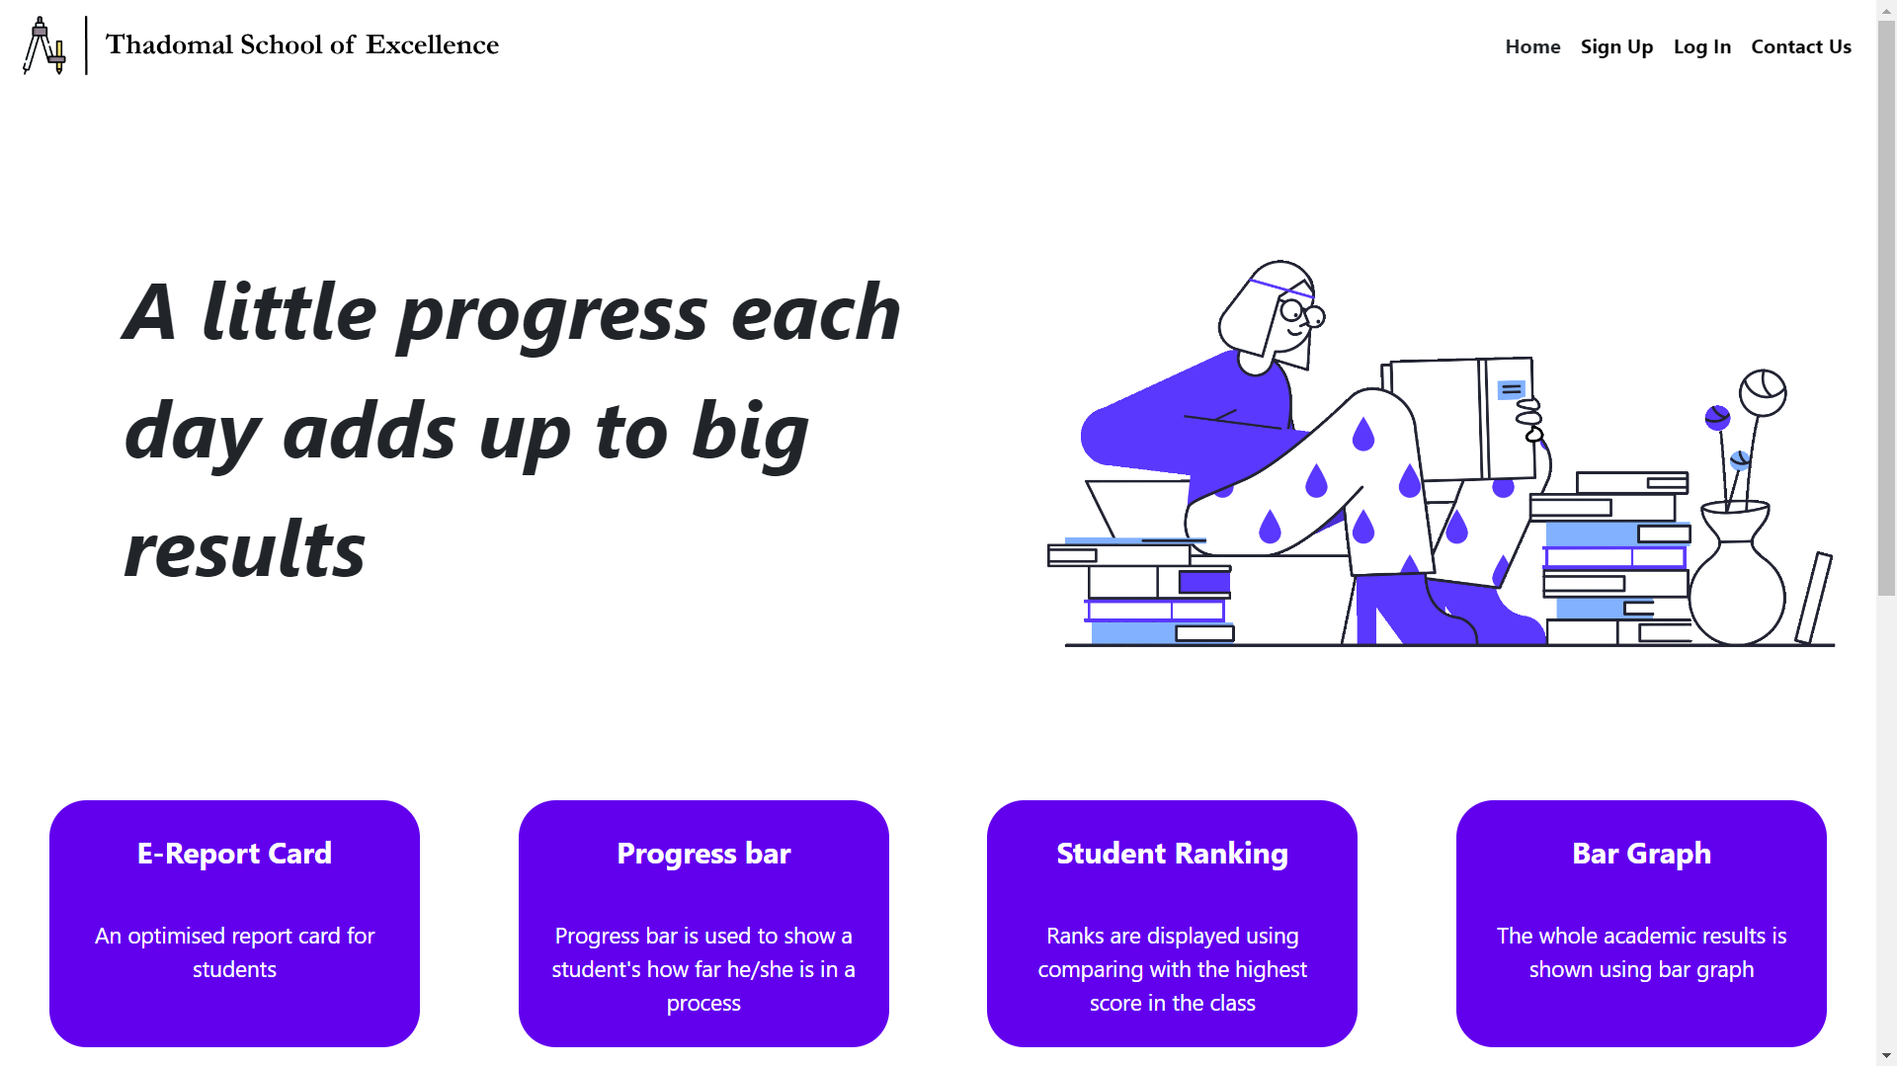

Slide 11
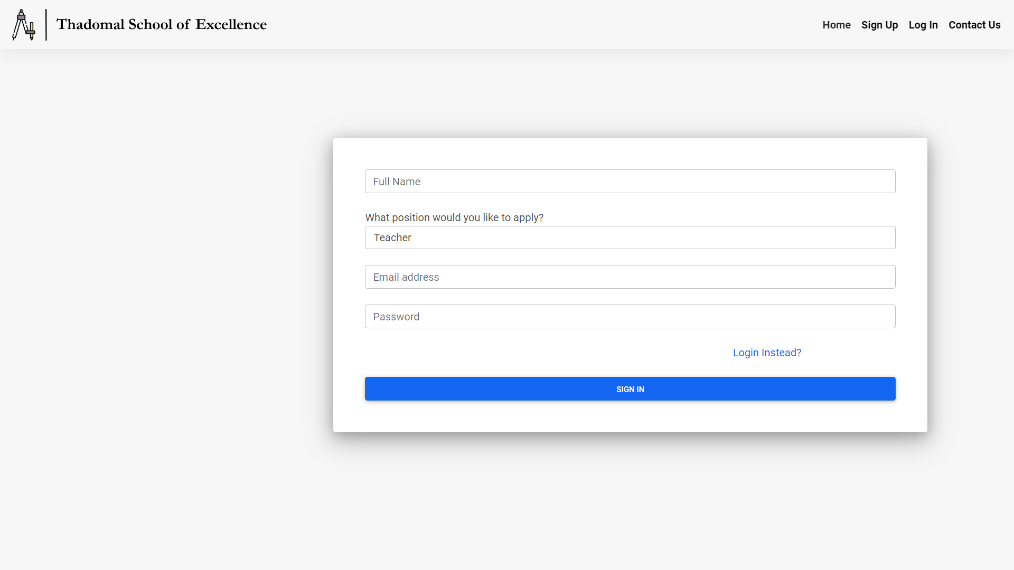
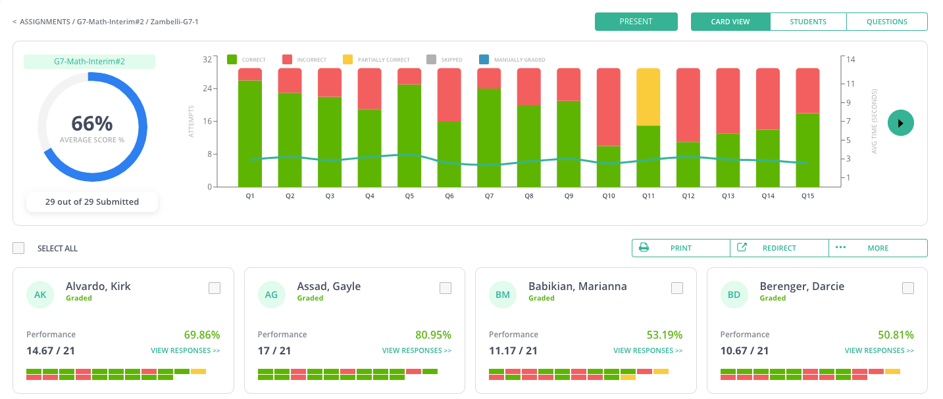
DASHBOARD
ATTENDANCE
ASSIGNMENT
GRADE SCORE
OVERVIEW
LOG OUT

Slide 12
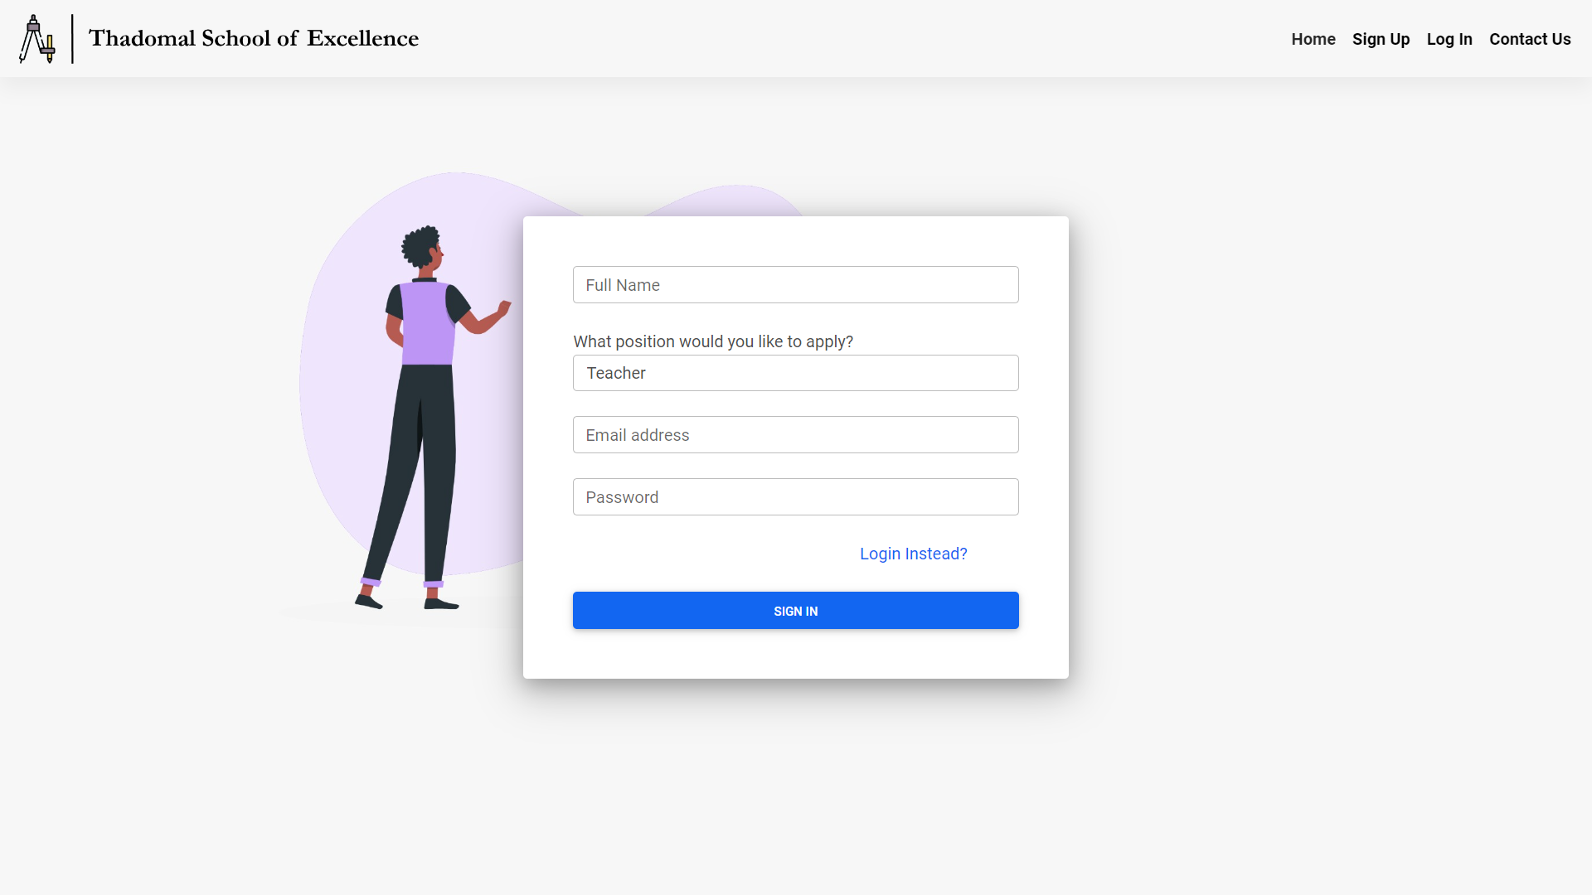
Teachers dynamic Portal
TOP PERFORMERS

Slide 13
Teachers dynamic Portal
NEEDS ATTENTION

Slide 14

OUR DIFFERENT APPROACH
We build a solution to the problem

Slide 15

OUR STUDENT FIRST APPROACH
An intuitive and user friendly representation of students' learning progress which helps teachers and parents to get visual feedbacks of their students' performance.

Slide 16

PARENTS PORTAL

Slide 17
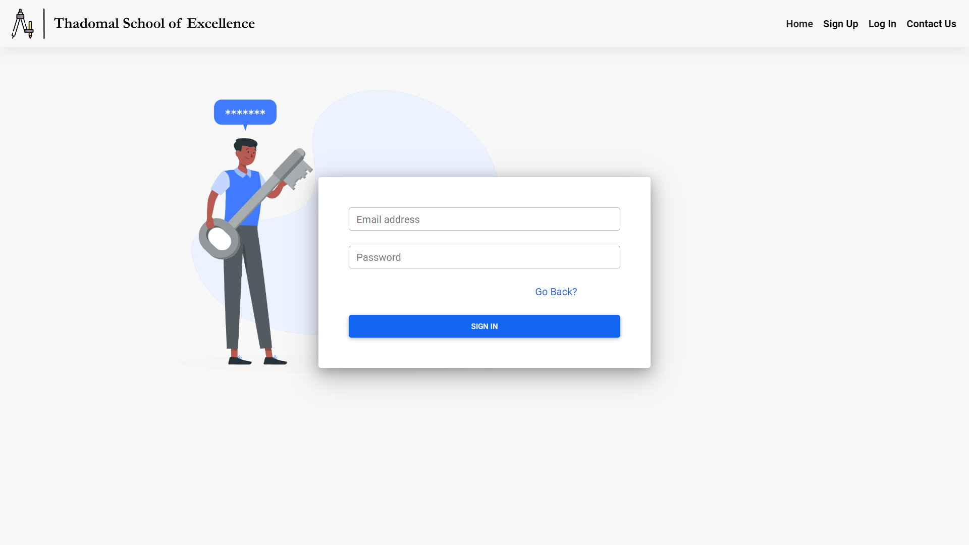
LOGIN PAGE

Slide 18
SIGNUP PAGE

Slide 19


Name : Neha Sharma
Class : Seven
Division : A
Attendance Report : 70 present / 100 days

Slide 20
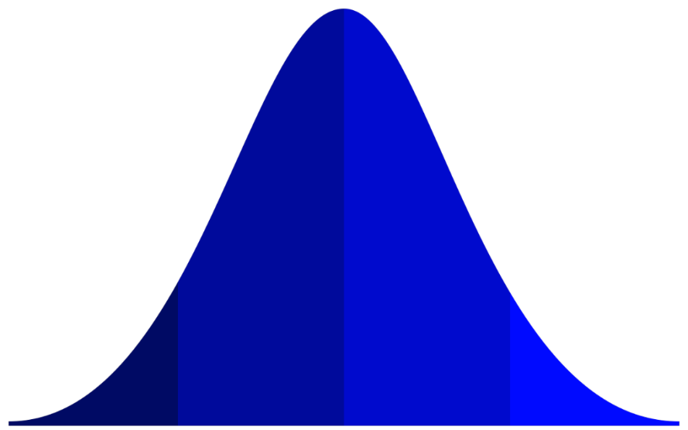
You are here!
Physics Unit Test Report

Slide 21
Overall Grade : A
Subjects Immediate Improvement Needed :
English
Arts
Subject Doing Fine
Social Science
Computer Programming
Subjects Doing Exceptional
Physics
Mathematics

Slide 22
Any Questions

